Slide 1






E-COMMERCE SALES ANALYSIS
Student Details
NAME: PRAVEEN KUMAR R
NM ID: au6128612821105015
COLLEGE NAME: VARUVAN VADIVELAN INSTITUTE OF TECHNOLOGY

Slide 2
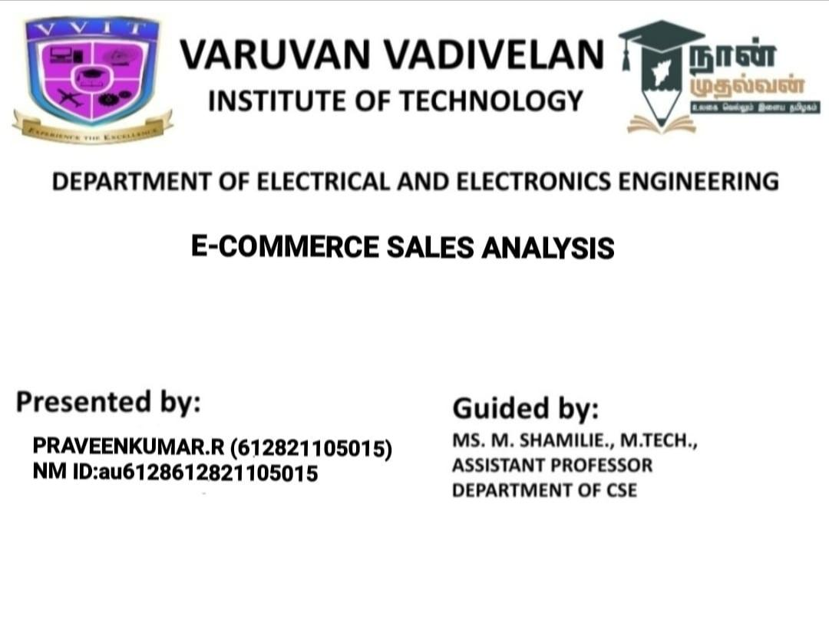


Slide 3
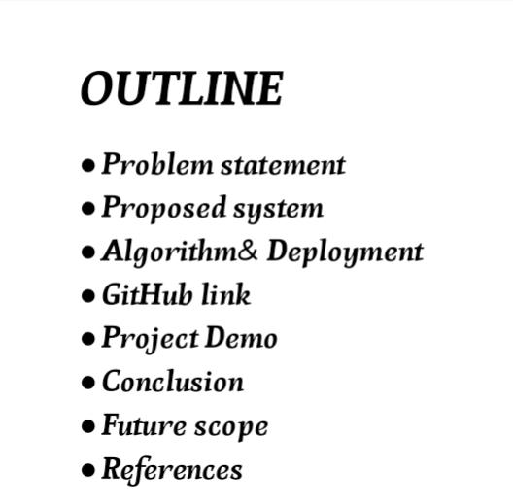


Slide 4
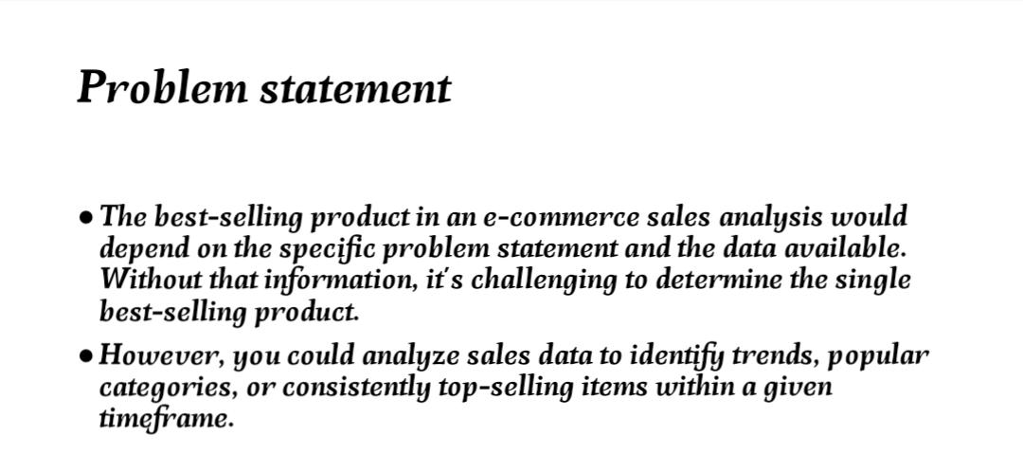



Slide 5
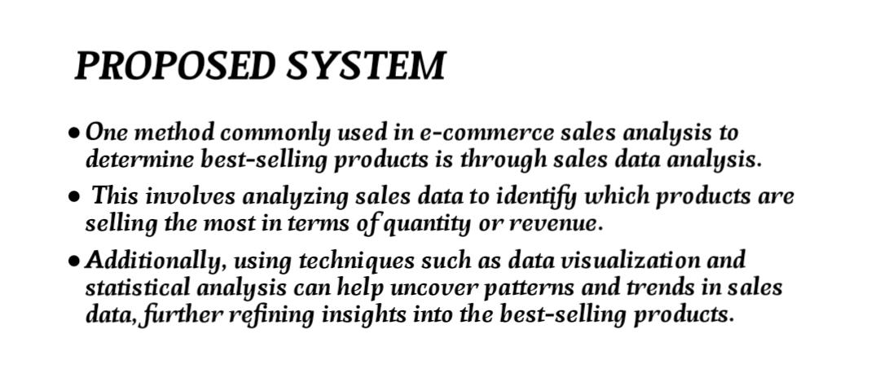



Slide 6
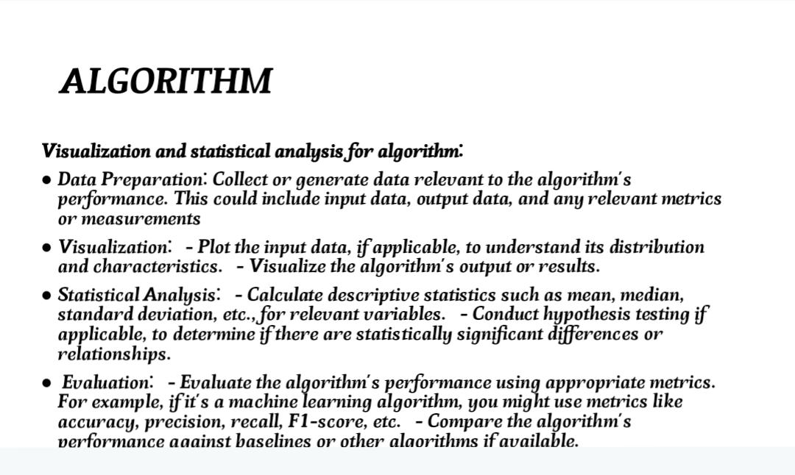

Aim and Objective

Slide 7
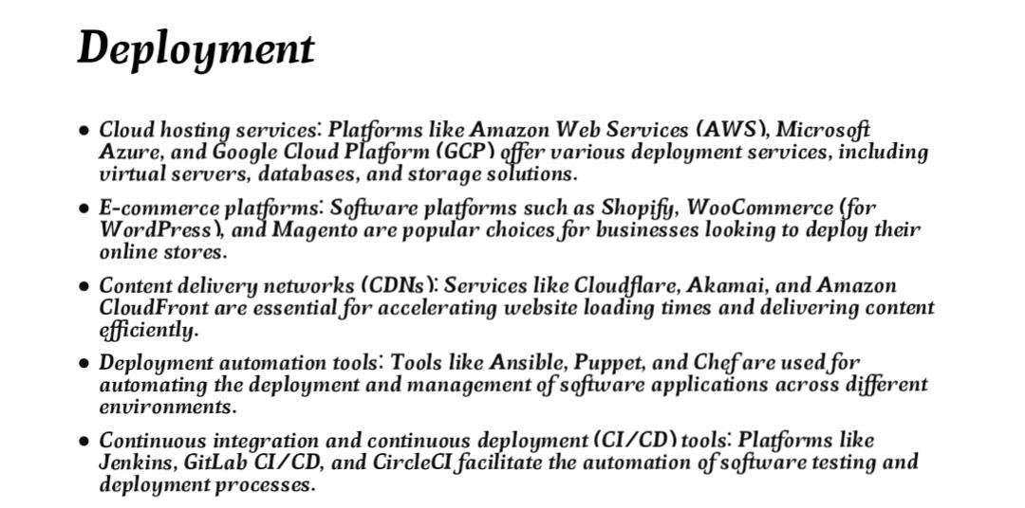

Slide 8
GITHUB LINK :
https://github.com/Praveenkumar102003
Notes:
8

Slide 9
PROJECT DEMO
https://github.com/praveenkumar102003/E_Commerce_Sales_Analysis
Notes:
9

Slide 10
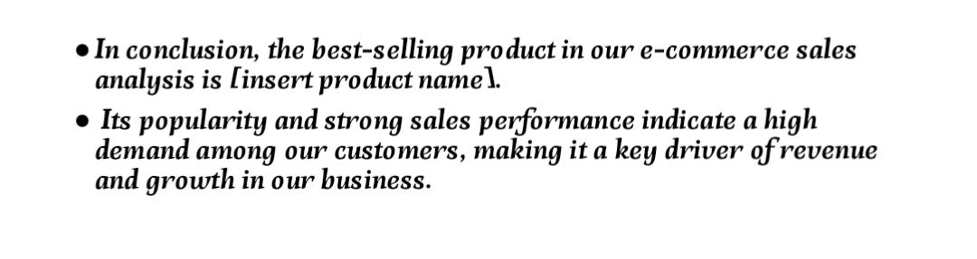

CONCLUSION :
Notes:
10

Slide 11

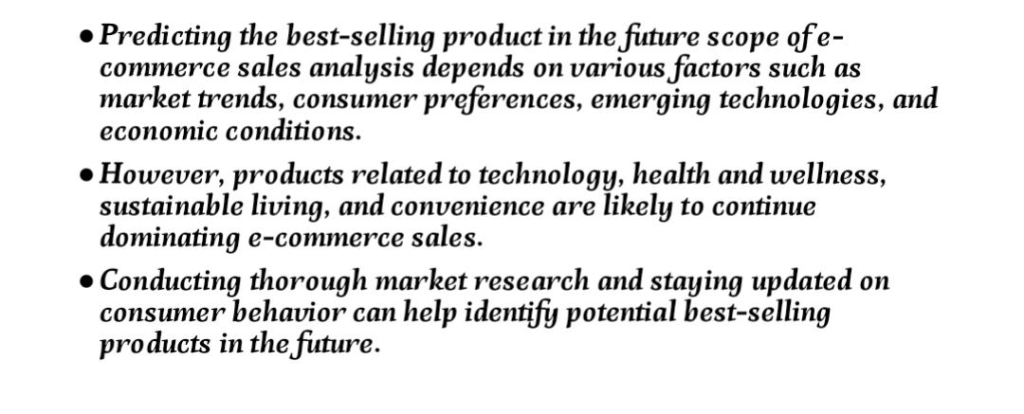
Future Scope
Notes:
11

Slide 12
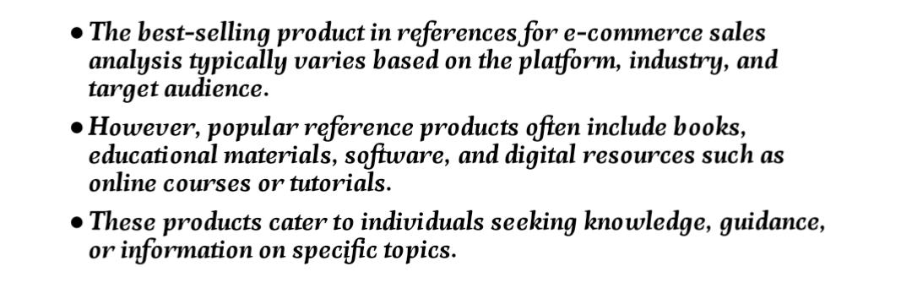
REFERENCS
Notes:
Reference
These are the references for this session.

Slide 13
Thank you!
Notes:
13

